Slide 1
Business Intelligence(BI)
Group 7:
Satyam Bhorwal
Atish Ghosh
Satyam Sundaram
Kumar Sanu
Prateek Tomar

Slide 2
Objectives
Introduction to Business Intelligence?
Components of Business Intelligence
ETL tools
Data Warehouse
Dimensional modeling
OLAP

Slide 3
What is Business Intelligence
The term was coined by Gartner group in 1993
It is an important component in today’s business information system environment
Business Intelligence (BI) is the process of getting useful information from data.
Turns data into Knowledge and Knowledge into business gain.
Collects and stores data into meaningful information in order to achieve better and timelier business decision.

Slide 4
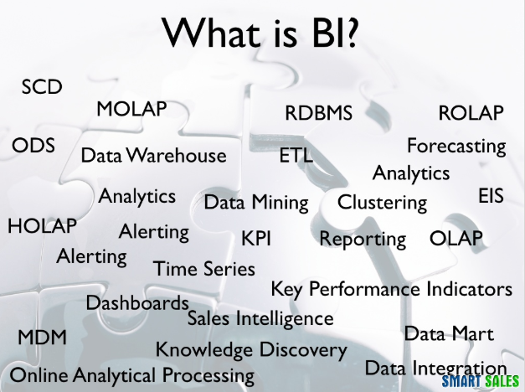

Slide 5
Need of BI
BI is important in helping organizations to stay ahead of the competition by providing the means for quicker, more accurate,and more informed decision making.
BI helps us to get the result of such questions:
What are my customers and what product are they buying?
What product promotions have biggest impact on revenue?
What are our lowest/highest margin customers?
Which customers are most likely to go the competitions?

Slide 6
Why Business Intelligence ?
Data analysis is a huge and crucial part of Business Intelligence.
Many organization need to know the overall performance and the way its business is functioning.
BI is used to gather present and past data.
Modern BI systems are capable of managing large amount of unstructured data.

Slide 7
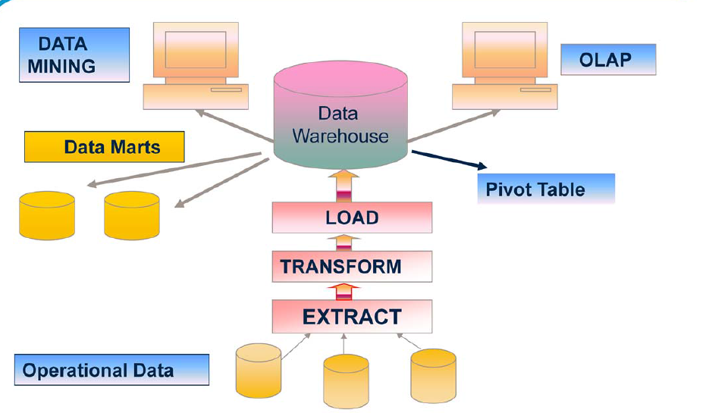
Components of BI

Slide 8
E T L
Extraction
Transformation
Loading

Slide 9
WHY ETL?
Companies need a way to analyze their data for critical business decisions.
Transactional Data directly can’t answer complex business questions.
A data warehouse provide a common data data repository.
ETL provide a method of moving the data from various source into a data warehouse.

Slide 10
ETL CONCEPT
A company data may be scattered in different locations and in different formats.
ETL allows you to:
1) Migrate the data into a data warehouse.
2) Convert the various formats and types to adhere to one consistent system.
ETL is a predefined process for access and manipulate source data and loading it into a target database.

Slide 11
Extract
The process of reading data from a database.
Transform
The process of converting data from one form to another.
Load
The process of writing data into the target database

Slide 12
EXTRACTION
Gathering the data
Raw data that was written directly into the disk
Data written to flat files or relational tables from structured source systems.
Data can be read multiple times, if needed.
Cleansing the data
Eliminating duplicates or fragmented data
Exclude unwanted and unneeded information

Slide 13
TRANSFORMATION
Preparing the data to be housed in the data warehouse
Converting the extracted data
Using rules and look-up tables
Combining data
Verification or Validity checks
Standardization

Slide 14
LOADING
Storing the transformed data in the data warehouse.
Batch/Real time processing.
Can follow star schema and snowflake schema

Slide 15
ADVANTAGE OF ETL TOOL
Simple,faster and cheaper development
Most ETL tools provide a metadata repository, synchronizing metadata from various sources.
Most ETL tools have built in connectors for all the major RDBMS.
Most ETL tools deliver good performance , even with very large dataset.
Most ETL tools allow reuse of existing complex programs.
Several ETL tools offer various performance optimization options such as (parallel processing, complex load balancing etc.)

Slide 16
POPULAR ETL TOOLS
Tools | Company
Infosphere Datastage | IBM
Informatica | Informatica Corp.
DT/Studio | Embarcadero Technologies
Ab Inito | Ab Inito Software Corp.
Oracle Warehouse Builder | ORACLE
Microsoft SQL Server Integration | Microsoft
Transformation Manager | ETL Solutions

Slide 17
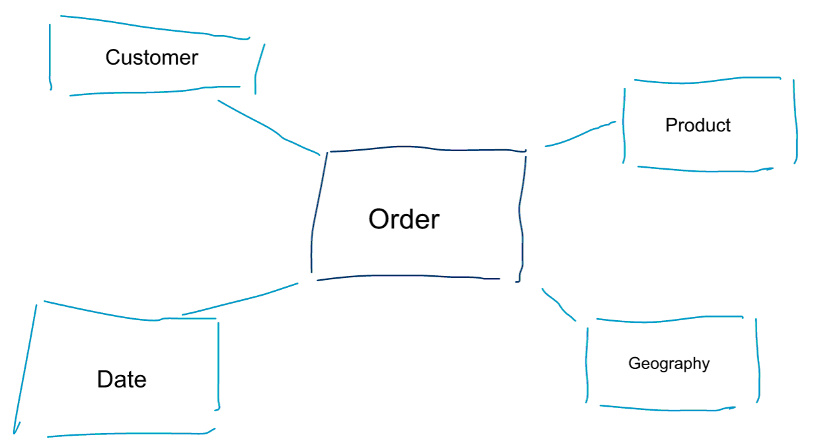
Dimensional Modeling

Slide 18
What is Dimensional Modeling?
Facts and Dimension Tables
Schema Design for Modeling

Slide 19
Dimensional Modeling
Logical design technique used for Data Warehouse
Technique for Databases designed to support end user queries in Data Warehouse

Slide 20
Facts and Dimension table
Dimension Model is composed of TWO tables
Fact Table
Dimension Table

Slide 21
Fact Table
Two Columns
Numeric Facts
Foreign Keys of Dimension Table
Dimension Table
Contains the attributes that describe fact records

Slide 23
Schema Design :
Star Schema :
Central fact table surrounded by dimension tables
Snowflake Schema :
Represents dimensional hierarchy

Slide 24
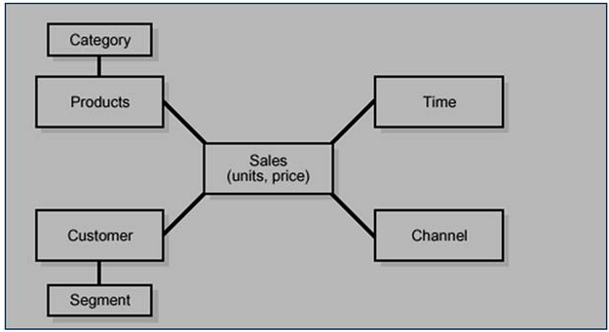
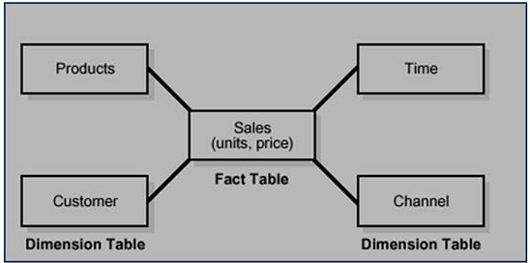
Star Schema
Snowflake Schema

Slide 25
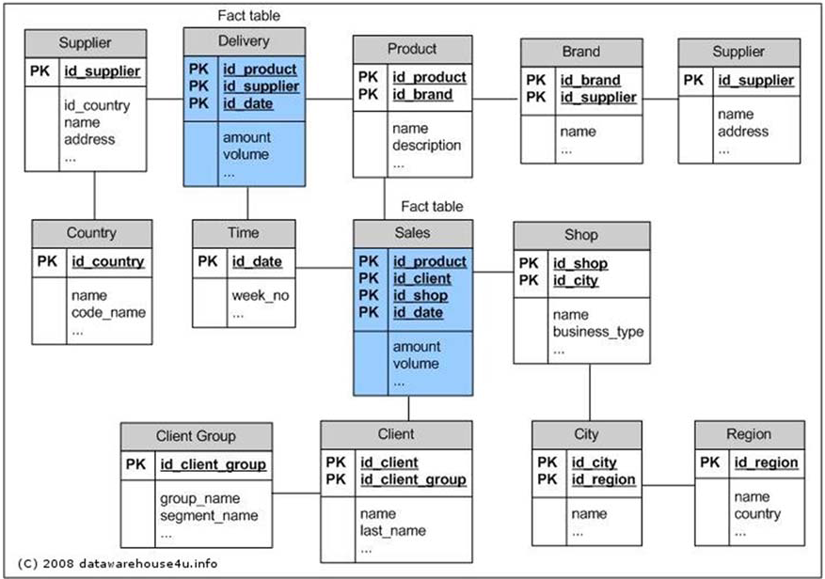
Fact Constellation (Galaxy Schema)
Multiple fact tables share dimension tables

Slide 26
OLAP(Online Analytical Processing)
OLAP (online analytical processing) is computer processing that enables a user to easily and selectively extract and view data from different points of view.
OLAP allows users to analyze database information from multiple database systems at one time.
OLAP data is stored in multidimensional databases.
OLAP processing is often used for data mining.

Slide 27
OLAP Cubes
An OLAP Cube is a data structure that allows fast analysis of data.
The arrangement of data into cubes overcomes a limitation of relational databases.
It consists of numeric facts called measures which are categorized by dimensions.
A multidimensional cube can combine data from disparate data sources and store the information in a fashion that is logical for business users.

Slide 28
History of OLAP
The term OLAP was created as a slight modification of the traditional database term OLTP (Online Transaction Processing).
Databases configured for OLAP employ a multidimensional data model, allowing for complex analytical and ad-hoc queries with a rapid execution time.
They borrow aspects of navigational databases and hierarchical databases that are speedier than their relational kind.

Slide 29
Types of OLAP :
Relational OLAP(ROLAP): Extended RDBMS with multidimensional data mapping to standard relational operation.
Multidimensional OLAP(MOLAP): Implemented operation in multidimensional data.
Hybrid OnlineAnalytical Processing (HOLAP) is a hybrid approach to the solution where the aggregated totals are stored in a multidimensional database while thedetail data is stored in the relational database. This is the balance between the data efficiency of the ROLAP model and the performance of the MOLAP model.

Slide 30
Conclusion:
Business Intelligence solutions make it possible for groups within organizations to gain actionable insight from business data, and to leverage these insights to meet critical goals.
Business intelligence solutions offer business focused analysis at a scale, complexity, and speed that is not achievable with basic operational systems reporting or spreadsheet analysis, thereby delivering significant value.

